Slide 1
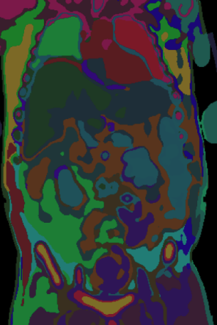
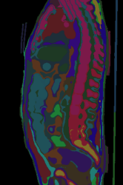

Low-Label 3D CT Segmentation
Refining the Experimental Design for nnU-Net and NV-Segment-CT
Adi, Arnav, Mina, Rayhan
Notes:
Our project asks whether a pretrained CT foundation model, NV-Segment-CT, actually reduces how much labeled data you need for 3D segmentation, compared with nnU-Net trained from scratch. This week we created our proposal and worked on our experimental planning.

Slide 2
Overview of Aims
Notes:
Aim 3 combines the first two. We measure the gap between NV-Segment-CT and nnU-Net under every scarcity condition, and look for where pretraining helps most: at which budgets, and for which anatomical structures. The rest of today is mostly about how we'll actually run and measure all of this.

Slide 3
Overview of Data Preprocessing
Notes:
Aim 3 combines the first two. We measure the gap between NV-Segment-CT and nnU-Net under every scarcity condition, and look for where pretraining helps most: at which budgets, and for which anatomical structures. The rest of today is mostly about how we'll actually run and measure all of this.

Slide 4
Aim 1A Updates: nnU-Net with Patient-Level Label Scarcity
Metrics
Loss functions
Interpretations
Notes:
Aim 3 combines the first two. We measure the gap between NV-Segment-CT and nnU-Net under every scarcity condition, and look for where pretraining helps most: at which budgets, and for which anatomical structures. The rest of today is mostly about how we'll actually run and measure all of this.

Slide 5
Aim 2A Updates: nnU-Net with Distributed Annotation Budget
Metrics
Loss functions
Interpretations
Notes:
Aim 3 combines the first two. We measure the gap between NV-Segment-CT and nnU-Net under every scarcity condition, and look for where pretraining helps most: at which budgets, and for which anatomical structures. The rest of today is mostly about how we'll actually run and measure all of this.

Slide 6
Aim 1B Updates: NV-Segment-CT with Patient-Level Label Scarcity
Metrics
Loss functions
Interpretations
Notes:
Aim 3 combines the first two. We measure the gap between NV-Segment-CT and nnU-Net under every scarcity condition, and look for where pretraining helps most: at which budgets, and for which anatomical structures. The rest of today is mostly about how we'll actually run and measure all of this.

Slide 7
Aim 2B Updates: NV-Segment-CT with Distributed Annotation Budget
Metrics
Loss functions
Interpretations
Notes:
Aim 3 combines the first two. We measure the gap between NV-Segment-CT and nnU-Net under every scarcity condition, and look for where pretraining helps most: at which budgets, and for which anatomical structures. The rest of today is mostly about how we'll actually run and measure all of this.

Slide 8
Next Steps

Slide 9
Project Formulation and Preprocessing for Low-Label 3D CT Segmentation
Refining the Experimental Design for nnU-Net and NV-Segment-CT
Adi, Arnav, Mina, Rayhan
Notes:
Our project asks whether a pretrained CT foundation model, NV-Segment-CT, actually reduces how much labeled data you need for 3D segmentation, compared with nnU-Net trained from scratch. This week we created our proposal and worked on our experimental planning.

Slide 10
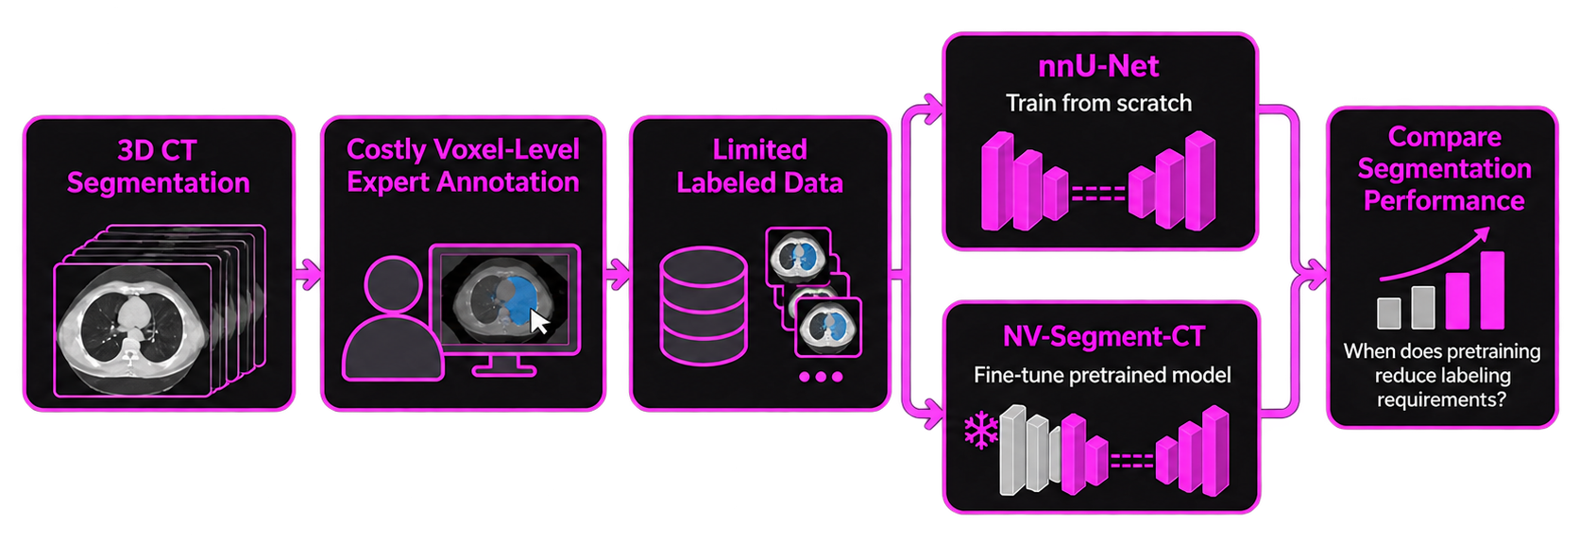
Project Recap
3D CT segmentation requires costly expert annotation
Goal: determine when pre training reduces labeling requirements
Notes:
Quick recap. 3D segmentation needs voxel-level labels from experts, which is slow and expensive, especially in head-and-neck CT where many structures are tiny and packed close together. Our goal is to find out when pretraining actually reduces that labeling burden. We train nnU-Net from scratch, fine-tune NV-Segment-CT, and compare them as we change how much labeled data each one gets.

Slide 11
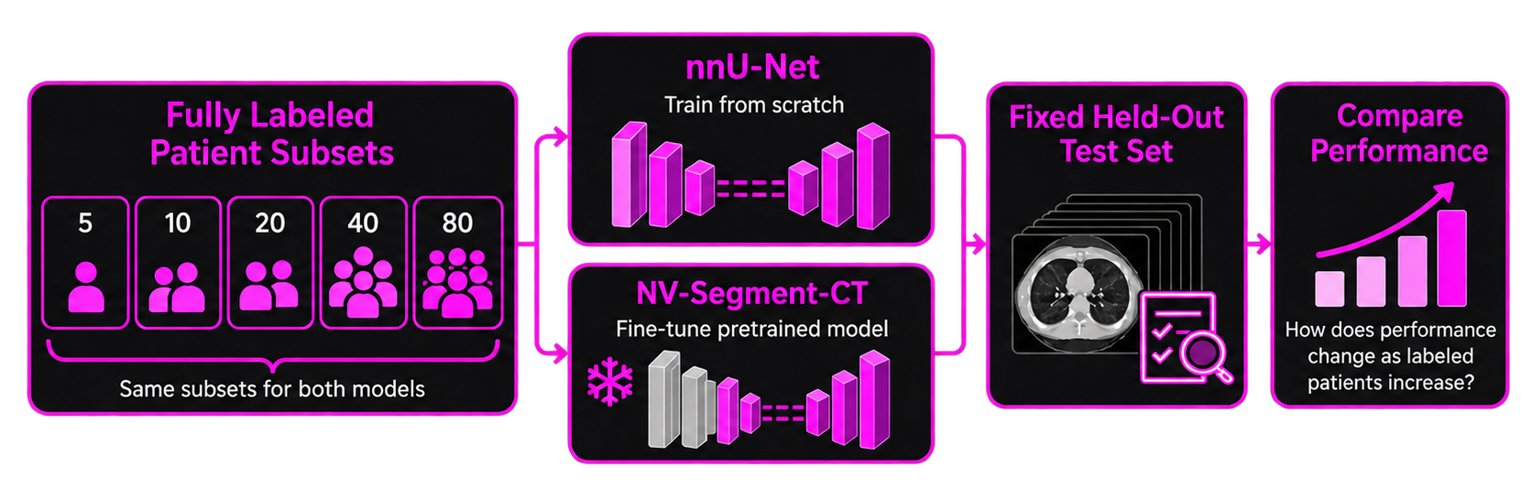
Patient-Level Label Scarcity
Takeaway: Compare both models across 5–100 fully labeled patients using the same held-out test set.
Notes:
Aim 1 is patient-level scarcity. We train both models on fully labeled subsets of 5, 10, 20, 40 and 80 patients, using the exact same subsets for both, and evaluate everything on one fixed held-out test set. That gives us a performance-versus-data curve for each model, which we can compare directly.

Slide 12
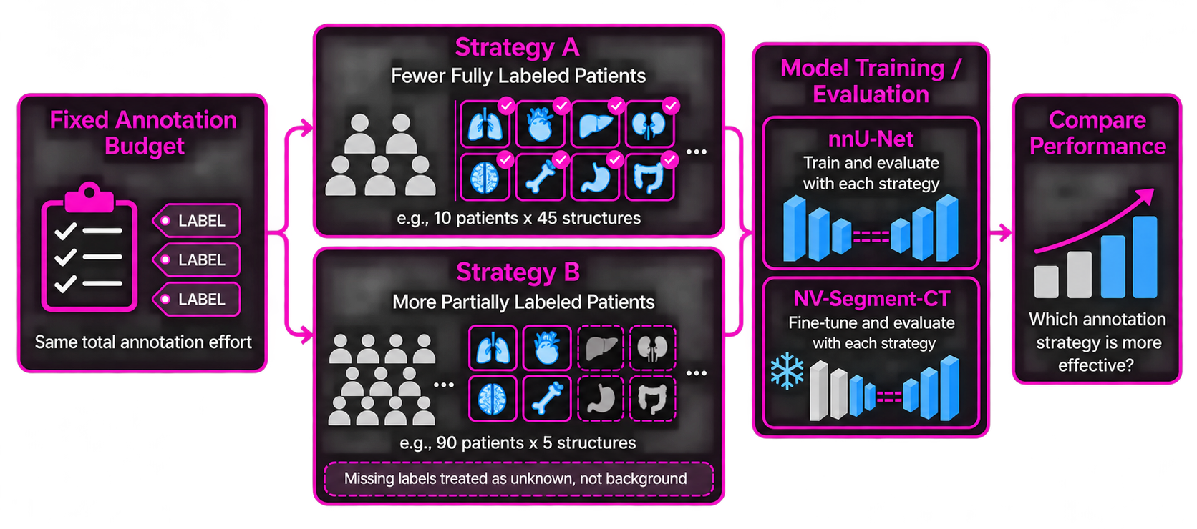
Annotation Distribution
Takeaway: Under a fixed annotation budget, compare fewer fully labeled patients with more partially labeled patients.
Notes:
Aim 2 asks a different question about the same budget: is it better to label densely or sparsely? For example, 10 patients with all 45 structures labeled, versus 90 patients with only 5 structures each. The total labeling effort is the same. Missing structures are treated as unknown, not background, so the model isn't penalized for organs nobody labeled.

Slide 13
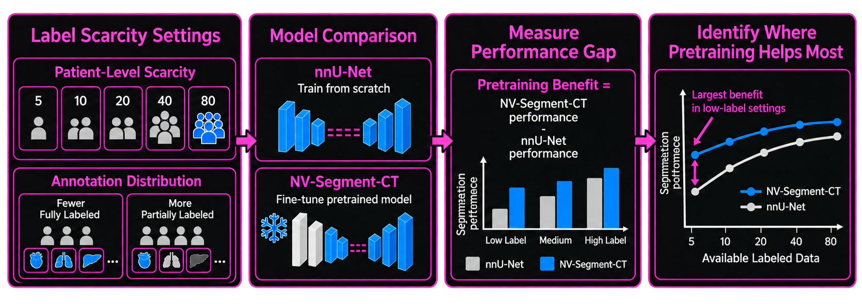
Value of Pre Training Under Label Scarcity
Takeaway: Measure where the performance advantage of pre training is largest across scarcity conditions.
Notes:
Aim 3 combines the first two. We measure the gap between NV-Segment-CT and nnU-Net under every scarcity condition, and look for where pretraining helps most: at which budgets, and for which anatomical structures. The rest of today is mostly about how we'll actually run and measure all of this.

Slide 14
nnU-Net Training Setup
Input
Non-contrast CT
+
Contrast CT
→ 2-channel 3D volume
OAR model
45 organs-at-risk
3d_fullres, from scratch
Training & inference
• 5-fold CV per label budget
• Dice + cross-entropy loss
• 33% of patches contain foreground
• Ensemble the 5 folds
• Remove stray false-positive blobs
GTV model
2 tumor volumes
trained separately
Notes:
Next, how we're training nnU-Net. The input is the non-contrast and contrast-enhanced CT stacked as a 2-channel volume. Non-contrast gives stable values for bone, and contrast highlights vessels and tumor.
We train two separate models: one for the 45 organs-at-risk and one for the 2 tumor volumes. Tumors vary a lot from patient to patient, and we don't want that variation destabilizing the boundaries of small organs. Both use the 3d_fullres configuration, which keeps fine in-plane detail.
For each label budget we run 5-fold cross-validation with nnU-Net's default Dice plus cross-entropy loss. The Dice term weights every class equally regardless of size, which helps tiny structures, and a third of training patches are forced to contain foreground. At inference we ensemble the five folds and let nnU-Net remove small disconnected false positives.

Slide 15
Fine-Tuning NV-Segment-CT
Unfreeze more as the budget grows
218M
11,454
127
Low N Freeze encoder; tune decoder + head
parameters
(3D transformer)
pretraining
CT volumes
pretrained
CT classes
Mid N Also unfreeze upper encoder blocks
Model adaptation
• No SegRap2023 in documented pretraining data
• Input → 2 channels (ncCT + ceCT)
• 127-class head → 47-class head (45 OARs + 2 GTVs)
High N Full fine-tuning
+ penalty keeping weights near pretrained values
Takeaway: Fine-tuning depth scales with the budget to avoid overfitting with only 5 patients.
Notes:
On the foundation-model side, NV-Segment-CT is built on VISTA3D. It's a 218-million-parameter 3D transformer pretrained on about 11,000 CT volumes covering 127 anatomical classes. We checked its documented training data, and SegRap2023 isn't in it, so there's no test leakage.
To adapt it, we change the input layer to take our 2 channels and replace the 127-class output head with a 47-class head for our 45 organs plus 2 tumor volumes.
The main risk is overfitting: fine-tuning 218 million parameters on 5 patients can destroy what the model learned in pretraining. So at low budgets we freeze the encoder and train only the decoder and head. As the budget grows we unfreeze more of the encoder, and at the highest budgets we fine-tune everything. At low budgets we also add a penalty that keeps the weights close to their pretrained values. Due to small amounts of data even at our “large” budget we may have to keep most of the model frozen across all the groups if encoder fine tuning loses too much useful pretraining.

Slide 16
nnUNet Training Compute Constraint
3.5 min
1,000
~58 h
~12 days
per epoch
(measured, 10 patients)
default epochs
(250 iterations each)
per fold
per budget
(5 folds, sequential)
Takeaway: Epoch cost doesn't shrink with fewer patients, so single-GPU training isn't feasible.
Notes:
The big practical finding this week was compute. We timed nnU-Net training on a 10-patient subset and got about 3.5 minutes per epoch. By default nnU-Net trains for 1,000 epochs. The catch is that an nnU-Net epoch is a fixed 250 training iterations, not a pass over the dataset. So a 5-patient run takes about as long as an 80-patient run; smaller budgets don't make training cheaper.
That works out to roughly 58 hours per fold, or about 12 days per label budget if we run the five cross-validation folds back to back. Across all our budgets, that's well over a thousand GPU-hours for the organ model alone.
So we're moving everything to the cluster. Each budget-and-fold pair becomes its own SLURM job, so all five folds train in parallel and one budget finishes in roughly two and a half days. nnU-Net needs high-memory nodes because the 46-class probability maps are huge, and for NV-Segment-CT we'll use mixed precision and gradient checkpointing to fit in GPU memory.

Slide 17
SegRap Labels vs. NV-Segment-CT Classes
5
10
18
14
47 SegRap2023 targets (45 OARs + 2 GTVs)
Direct match (5)
Brain, esophagus, spinal cord, thyroid, trachea
Sub-region (10)
Brainstem, hippocampus, larynx, oral cavity, temporal lobes
Nearest: skull (18)
Cochlea, mandible, middle ear, mastoid, TMJ
No analog (14)
Chiasm, eyes, lens, optic nerves, parotids, pituitary, GTVs
Takeaway: 89% of targets have no direct pretrained class
Notes:
This slide shows how well our targets line up with what NV-Segment-CT already knows. Of the 47 SegRap targets, only 5 have a direct pretrained class, like brain, spinal cord and trachea. Another 10 are sub-regions of an organ it supports, like the brainstem or larynx. 18 are closest to the generic skull class; these are temporal-bone structures like the cochlea and middle ear. And 14 have no analog at all, including the optic structures, the parotid glands and both tumor volumes.
So about two-thirds of what we're segmenting has no direct pretrained class. We expect pretraining to help least for those.

Slide 18
Resolution Risk for Small Organs
SegRap2023 native
nnU-Net plan
NV-Segment-CT default
0.55 × 0.55 × 3.0 mm
0.55 × 0.55 × 3.0 mm
1.5 × 1.5 × 1.5 mm
Fine in-plane, thick slices
Keeps native in-plane detail
~2.7× coarser in-plane
Check
• Volume, voxel count and boundary of small OARs before vs. after resampling
• Visual spot-checks of cochlea, lens, optic nerves
If small OARs degrade
• Finer voxel spacing (more compute)
• Coarse-to-fine: crop a region, segment at native resolution
Takeaway: We verify small structures survive preprocessing before trusting small-OAR results.
Notes:
A related risk is resolution. SegRap scans are very anisotropic: about 0.55 millimeters in-plane but 3 millimeters between slices. nnU-Net's plan keeps that native in-plane resolution. NV-Segment-CT, by default, resamples everything to 1.5 millimeter isotropic voxels, which is about 2.7 times coarser in-plane.
For big organs that's fine, but structures like the cochlea, lens or optic nerves are only a handful of voxels to begin with, and they could shrink or disappear entirely. So before trusting any small-organ result, we'll compare volume, voxel count and boundary shape before and after resampling, and spot-check them visually. If they degrade, we can use finer spacing at extra compute cost, or a coarse-to-fine approach: find the region first, then segment it at native resolution.

Slide 19
Quantifying the Pretraining Advantage
ΔDSC = DSC(NV-Segment-CT) − DSC(nnU-Net)
per patient and per structure
Crossover point
Smallest N where nnU-Net is no longer better on average across structures
Label-efficiency ratio
Patients nnU-Net needs to match NV-Segment-CT at N patients
Minimum annotation
Smallest N reaching mean DSC 0.80 over all 45 OARs
This assumes pre training provides an advantage originally which must be verified
Notes:
Aim 3 turns the comparison into concrete numbers. The pretraining advantage is ΔDSC: NV-Segment-CT's Dice minus nnU-Net's, computed per patient and per structure, with the same difference for HD95.
From the Aim 1 curves we extract three summary measures. The crossover point is the smallest budget at which nnU-Net is no longer worse. The label-efficiency ratio is how many patients nnU-Net needs to match NV-Segment-CT at a given budget: for example, a ratio of 4 at N equals 10 means pretraining is worth about 30 extra labeled patients. And the minimum annotation requirement is the smallest budget at which each model reaches a mean Dice of 0.80 across the 45 organs.
From Aim 2, we'll also check whether the advantage is bigger with dense or with sparse labeling at the same budget.

Slide 20
Separating Pretraining from Architecture
nnU-Net
CNN · random init
NV-Segment-CT control
Transformer · random init
NV-Segment-CT
Transformer · pretrained
Δ Architecture effect
Δ Pre Training effect
Control setup
• Same architecture, inputs, head, schedule
• Trained only at N = 5, 20, 80
Expectation
• Control trails nnU-Net at low N
• Tells us that low-N gains come from pretraining
Takeaway: The control lets us credit low-budget gains to pretraining, not to the transformer.
Notes:
One issue with comparing these two models directly is that they differ in two ways at once: pretraining, and architecture, since nnU-Net is a CNN and NV-Segment-CT is a transformer. To separate the two, we add a control: NV-Segment-CT trained from random initialization, with the same architecture, inputs, head and training schedule.
Comparing the fine-tuned model with this control isolates the effect of pretraining, and comparing the control with nnU-Net isolates the effect of architecture. To limit compute, we only train the control at three budgets: 5, 20 and 80 patients.
We expect the control to do worse than nnU-Net at low budgets, since transformers trained from scratch typically need more data. If so, any advantage NV-Segment-CT shows at low budgets can be credited to pretraining rather than to the transformer.

Slide 21
Expected Timeline
Week 8 (next week) | Partition dataset, adapt and test (N=5) nnU-Net and NV-Segment-CT to cluster
Week 9 | Audit metrics for microscopic OARs → adapt nnU-Net and NV-Segment-CT workflow as necessary
Week 10 | Low-budget experiments (N = 5, 10, 20)
Week 11 | High-budget experiments (N = 40, 60, 80, 100)
Week 12 | Evaluation, stratification analysis
Week 13 | Buffer period for troubleshooting (rerun cluster jobs as necessary)
Week 14 | Organize results, create presentation slides
Week 15 (presentation week) | Prepare for presentation

Slide 22
Questions?
Notes:
Thanks, we're happy to take questions.

Slide 23
Next Steps
Next week
• Launch 5-patient nnU-Net baseline via SLURM
• Verify training → inference → evaluation
• Set up NV-Segment-CT (2-channel input, 47-class head)
• Check small OARs after resampling
Notes:
To summarize this week: we benchmarked nnU-Net training cost and moved training to the cluster, specified the NV-Segment-CT fine-tuning setup, mapped the SegRap labels to pretrained classes, and finalized the evaluation and Aim 3 analysis plan.
Next week we'll launch the 5-patient nnU-Net baseline on the cluster and verify the whole pipeline, from training through inference to evaluation. In parallel, we'll get NV-Segment-CT running with the new input layer and head, and run the resampling check on small organs. We'll also write up the detailed design for Aim 2, the partial-label experiments.

Slide 24
Project Formulation and Preprocessing for Low-Label 3D CT Segmentation
Refining the Experimental Design for nnU-Net and NV-Segment-CT
Adi, Arnav, Mina, Rayhan
Notes:
Hi everyone, I’m Adi and I am going to be presenting for Group 7. Our group is looking to evaluate how foundation models compare to more traditional 3D CT Segmentation algorithms, particularly in low label regimes. I’m working with Arnav, Mina, and Rayhan on this project. Today I’ll be talking about our exploratory data analysis for our training dataset specifically the scan and annotation characteristics for low label training

Slide 25
Project Recap
3D CT segmentation requires costly expert annotation
Goal: determine when pretraining reduces labeling requirements

Slide 26
Specific Aim 1 ~ Patient-Level Label Scarcity
Takeaway: Compare both models across 5–80 fully labeled patients using the same held-out test set.

Slide 27
Specific Aim 2 ~ Annotation Distribution
Takeaway: Under a fixed annotation budget, compare fewer fully labeled patients with more partially labeled patients.

Slide 28
Specific Aim 3 ~ Value of Pretraining Under Label Scarcity
Takeaway: Measure where the performance advantage of pretraining is largest across scarcity conditions.

Slide 29
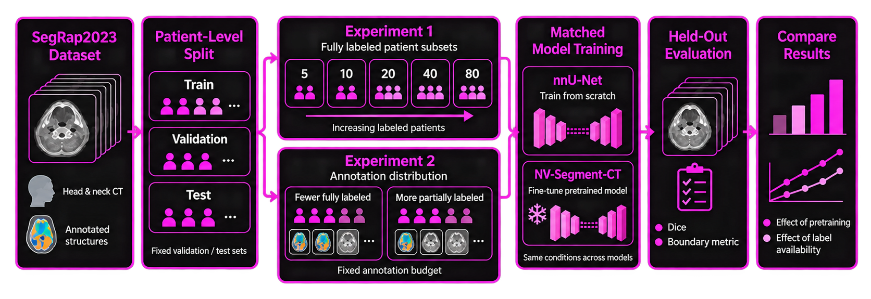
Experimental Design
Takeaway: Both models are evaluated under matched data splits, target structures, and test conditions.
Evaluation Metrics: Dice Score + Boundary-Sensitive Metric

Slide 30
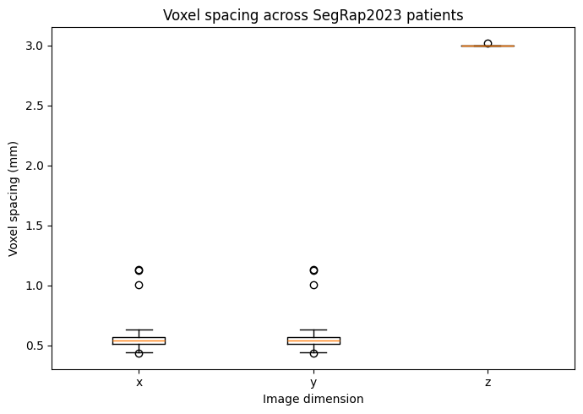
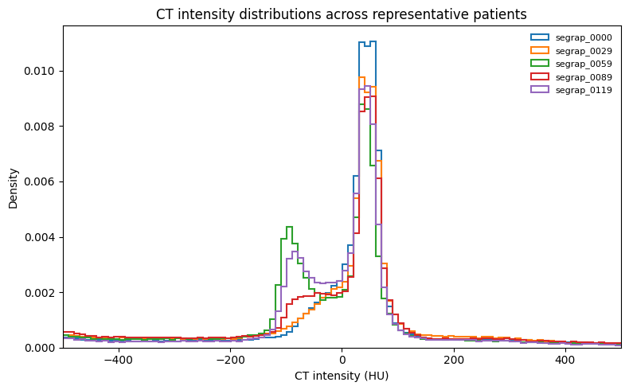
What Our EDA Revealed
Key Takeaway: Variation in scan geometry and intensity distributions motivates standardized preprocessing before model training.

Slide 31
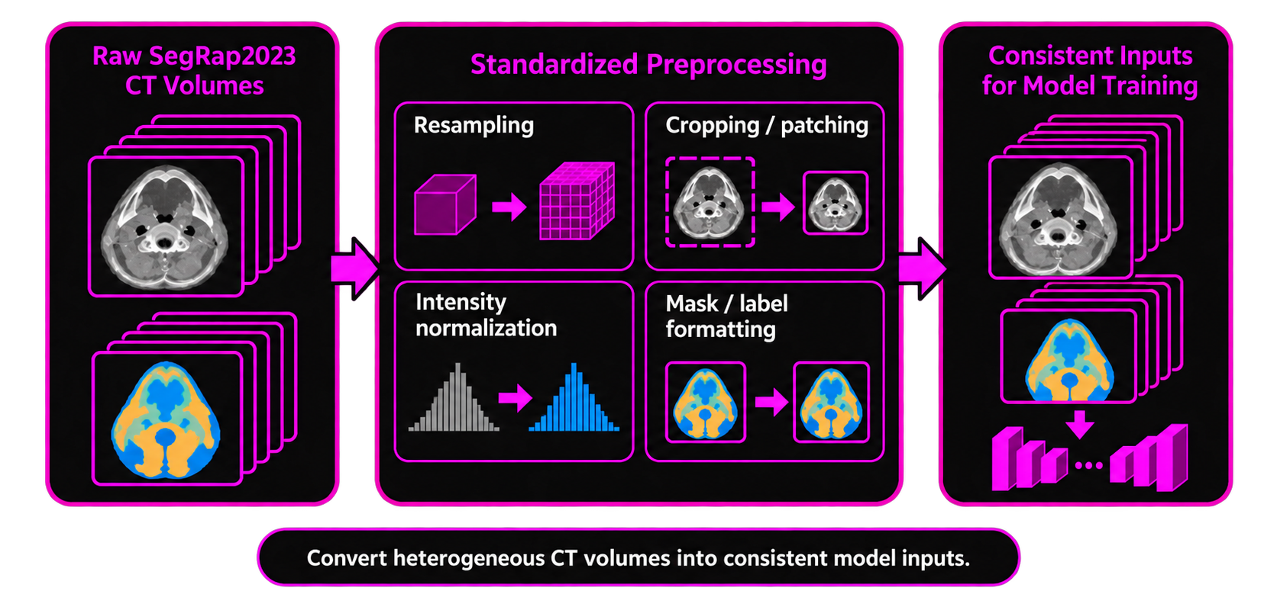
Preprocessing: What Needs to Be Standardized?
Takeaway: Spatial, intensity, and label inconsistencies must be standardized before training.

Slide 32
Why We Chose nnU-Net as the Baseline
Manual / Custom 3D U-Net Pipeline
Manual preprocessing decisions
Manual spacing/patch size
More arbitrary tuning
nnU-Net
Automatic data-driven preprocessing
Dataset-adaptive configuration
Standardized medical segmentation baseline
Why it matters: we want performance differences to reflect the models, not arbitrary preprocessing choices

Slide 33
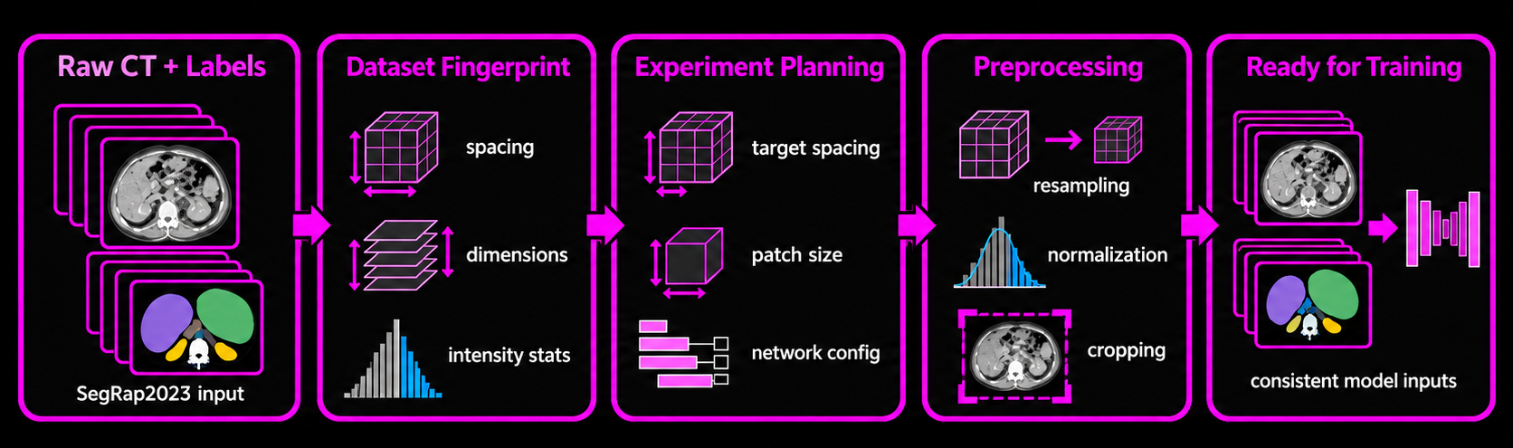
nnU-Net Preprocessing Pipeline
Takeaway: nnU-Net converts dataset characteristics into a standardized preprocessing and training configuration.

Slide 34
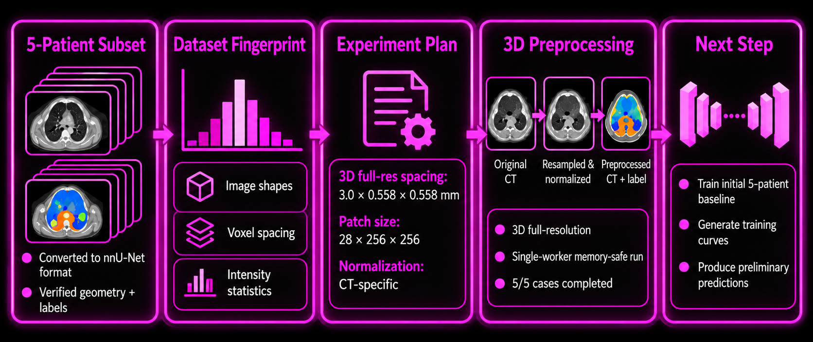
Initial nnU-Net Preprocessing Results
Takeaway: The nnU-Net preprocessing pipeline was successfully validated on the initial 5-patient subset and is ready for baseline training.

Slide 35
Accounting for OAR Class Imbalance
Organs-at-risk (OARs) vary wildly in volume. Default nnU-Net configurations mitigate, but do not fully solve, extreme class imbalance.
Steps to Try:
Baseline nnU-Net-Based Interventions
  Run nnUNetv2_find_best_configuration command (regularization technique).
  Run nnUNetv_determine_postprocessing command (removing small disconnected components to see if this improves Dice score for specific classes).
(If #1 does not work) Implement region-based training
  Group many OARs with highly variable volumes into hierarchical anatomical regions (e.g. brain structures, optical structures) as metadata
(If #1 & #2 do not work) Build custom trainer class
  Override loss function (e.g. focal loss function)
  Force foreground sampling rule to oversample tiny classes
Notes:
45 OARs vary wildly in volume. By default, the nnU-Net employs (1) compound dice + cross entropy loss function and (2) foreground oversampling rule (which guarantees that 33.3% of sampled training patches contain at least one foreground class) – this mitigates but does not fully solve extreme class imbalance.
· Dice score – measures similarity and spatial overlap between two sets of data. In medical image segmentation, evaluates how closely an automated organ/tumor boundary matches a human expert’s ground-truth mask.
· Cross entropy loss function – measures difference between a model’s predicted probability distribution and true distribution of categorical labels in classification tasks.
o Focal loss function – modifies standard cross-entropy to addressing extreme class imbalance by dynamically down-weighting loss assigned to easy, well-classified examples.
· Foreground oversampling rule – exactly 33% of sampled training patches are forced to contain a foreground region rather than pure background. Because medical imaging datasets often consist largely of background voxels, this strategy prevents nnU-Net from wasting training iterations on empty background and forces it to consistently learn organ/tumor segmentations.
Roadmap for solving for extreme class imbalance:
1. Phase 1: nnU-Net-Based Interventions
a. Stick to default train.py setup and train standard 3d_fullres model across all 5 folds.
b. Run nnUNetv2_find_best_configuration command (at bottom of colab_runner.ipynb).
i. Ensembling predictions from 5 folds = averaging softmax probabilities across 5 models. Acts as a strong regularization technique, sooths out noise on tiny class boundaries that a single fold may miss.
c. Run nnUNetv2_determine_postprocessing command (at bottom of colab_runner.ipynb).
i. Searches validation set to see if removing small disconnected components (blobs) improves Dice score for specific classes automatically creates optimal post-processing plan.
2. Phase 2: Updating prepare_dataset.py script if smallest OARs still vanishing after ensembling.
a. Implement Region-Based Training in dataset.json generation step: Group 45 SegRap2023 classes into hierarchical anatomical regions, e.g. optical structures, brain structures, glandular structures.
i. Metadata mapping may give the model broader spatial context without touching the core neural network logic.
3. Phase 3: Custom trainer class
a. Write custom trainer class to override loss function (e.g. with focal loss function) or to manually force sampler to oversample tiny classes.
i. Last resort because custom trainers require overriding nnU-Net’s internal logic and updating train.py to pass -tr flag adds technical debt and debugging complexity to codebase.

Slide 36
Progress Summary
Completed EDA and characterized key dataset variability
Refined project questions, specific aims, and experimental design
Selected nnU-Net as the baseline and converted a 5-patient subset
Completed fingerprinting, experiment planning, and 3D preprocessing for 5/5 patients

Slide 37
Plan for Next Week
Train the initial 5-patient nnU-Net baseline
Generate preliminary training curves and segmentation predictions
Verify the full training → inference → evaluation pipeline
Finalize evaluation metrics for the first baseline run

Slide 38
Questions?

Slide 39
Exploratory Analysis of SegRap2023 for 3D CT Segmentation
Scan and Annotation Characteristics for Low-Label Training
Adi, Arnav, Mina, Rayhan
Notes:
Hi everyone, I’m Adi and I am going to be presenting for Group 7. Our group is looking to evaluate how foundation models compare to more traditional 3D CT Segmentation algorithms, particularly in low label regimes. I’m working with Arnav, Mina, and Rayhan on this project. Today I’ll be talking about our exploratory data analysis for our training dataset specifically the scan and annotation characteristics for low label training

Slide 40
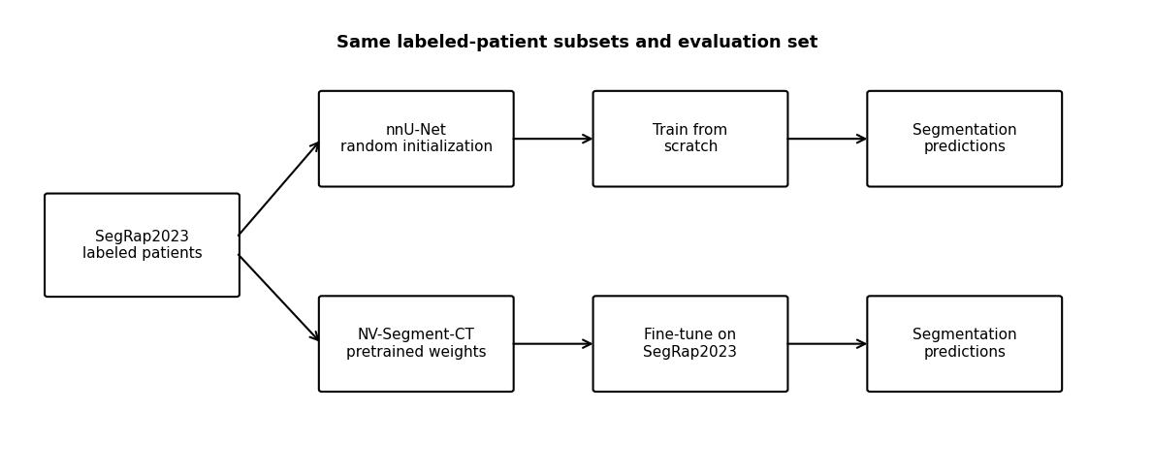
Project Recap
Research Question: Does pretraining improve 3D CT segmentation performance when labeled training data are limited?
nnU-Net (train from scratch) vs. NV-Segment-CT (fine-tune foundation model)
Notes:
nnu-net relies on trad unet architectures
nv-segmentct released nvidia,2024.
We have confirmed that SegRap was not part of the NV-SEGMENT-CT dataset. We hypothesize that with few datapoints a model trained from scratch will do poorly as compared to a foundation model but as more data is included, our traditional model may do better. We aim to test a model looking at varying subset sizes of CT scans and test performance on a held out set.

Slide 41
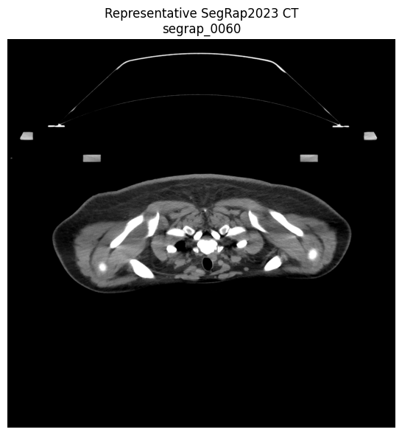
SegRap2023 Dataset Overview
Why SegRap2023? Its patient-level 3D CT scans and detailed anatomical annotations allow us to systematically reduce the amount of labeled training data while keeping evaluation consistent
120 + 20 + 60 patients (training, validation, test)
Head & neck CT
ncCT + ceCT
3D patient-level volumes
Detailed anatomical labels
Notes:
We chose this dataset because it consists of CT scans that were manually labeled as ground-truth by oncologists. This allows us to keep a consistent baseline to evaluate the models we are testing to.
This dataset contains 120 training datasets - these are what we’ve accessed so far, 20 as a validation set to tune hyperparameters, and a 60 patient dataset for testing. The CT scans are taken from patients with nasopharyngeal carcinoma (NPC) and label 45 organ regions and 2 general tumor volumes within CT scans. Both non-contrast and contrast CT scans have been taken. CT scans across the axial plane were taken, while the saggital and coronal views are inferred from these axial slides.
On the right you can see an example of these CT scans. In the top you can see artifacts due to the field capturing outer artifacts. Implying that we will have to segment out the general region for evaluation.

Slide 42
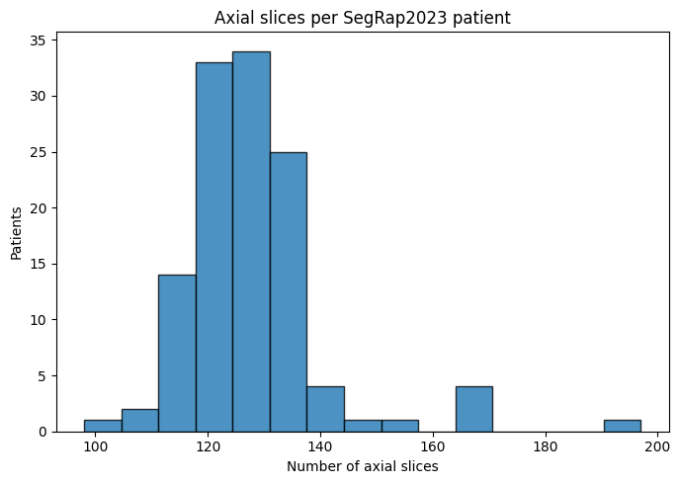
SegRap2023 Slices Vary Spatially
Takeaway: Variation in scan dimensions and spatial resolution determines whether spatial standardization is needed before model training.
Notes:
motivates normalizing loss to patient or to slice? will need to think about it and ensuring voxel size are standardized

Slide 43
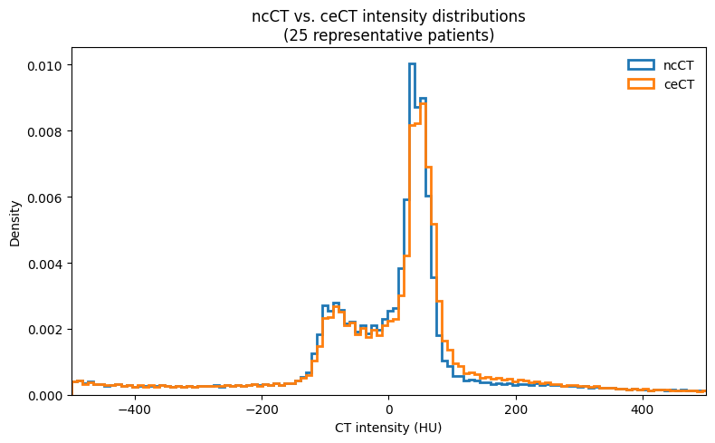
CT Intensity Distributions and Normalization
Takeaway: Comparing intensity distributions across scans and modalities will inform the intensity preprocessing used before training.
Notes:
motivates intensity normalization

Slide 44
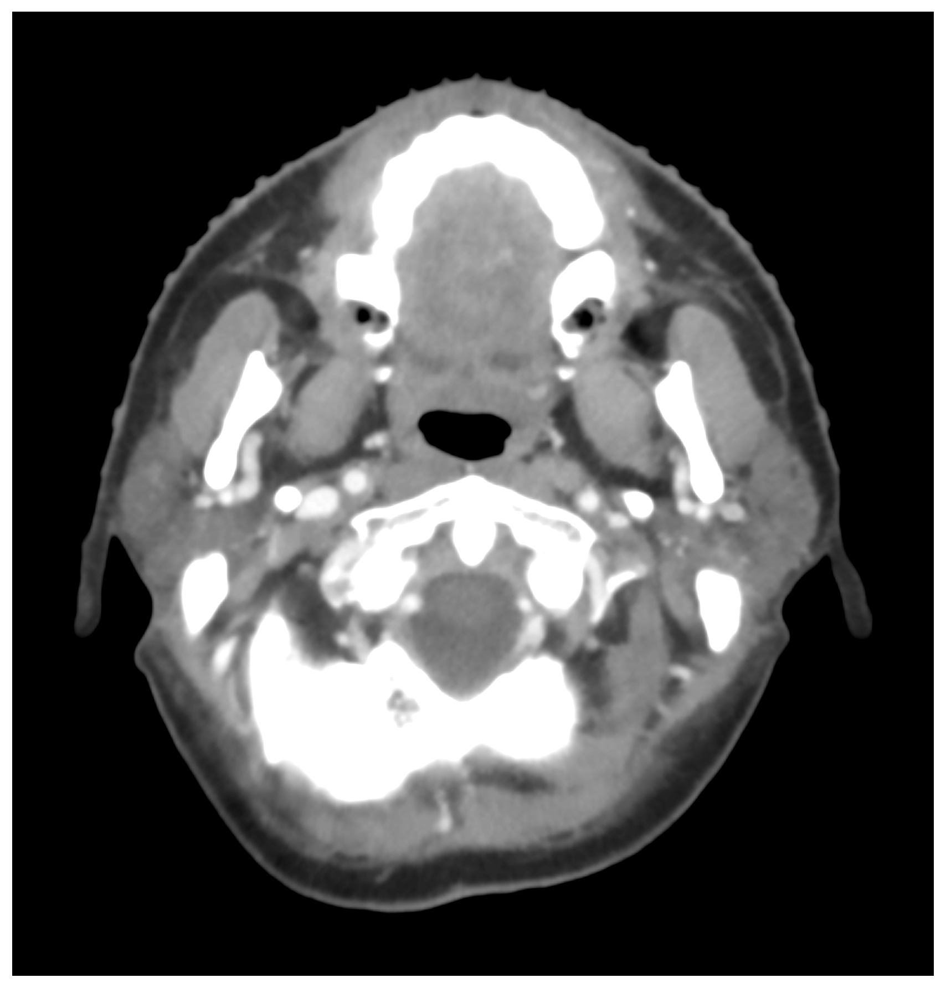
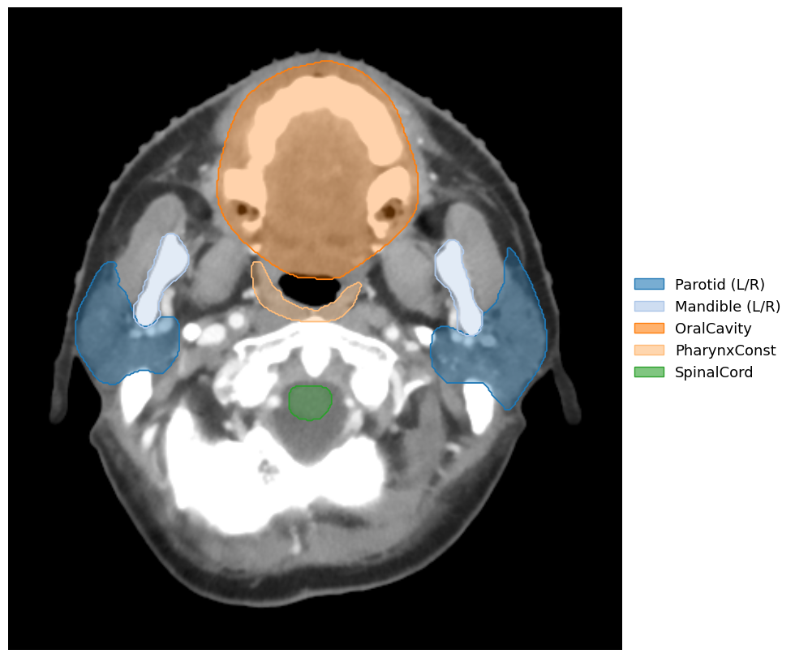
Visualizing SegRap2023 Annotations
Takeaway: SegRap2023 includes labeled structures across individual 2D slices
Individually annotated regions
Raw Axial CT
Labeled Axial CT

Slide 45
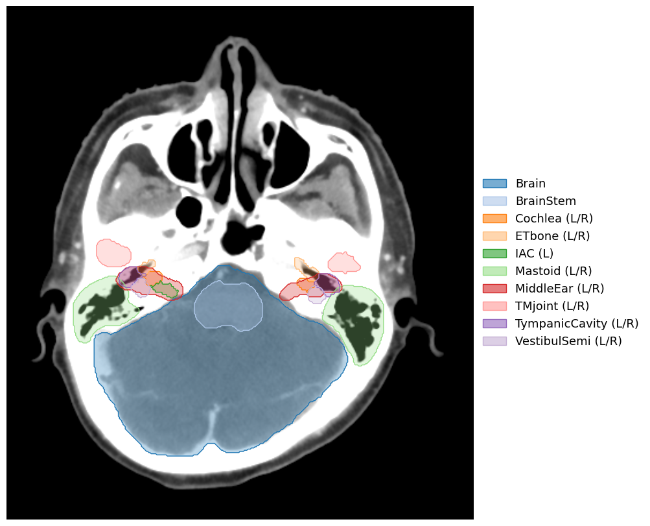
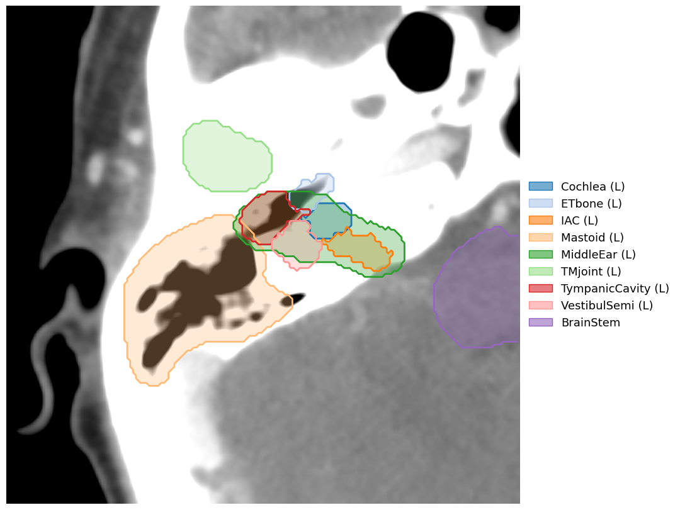
SegRap2023 Annotations Include Complexity
Takeaway: SegRap2023 contains structures with substantially different spatial relationships, including nested and overlapping anatomical regions.
Detailed Segmentation
Overlapping regions

Slide 46
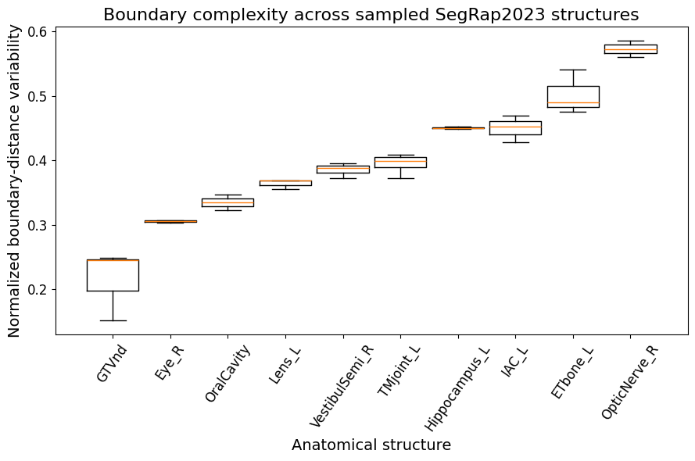
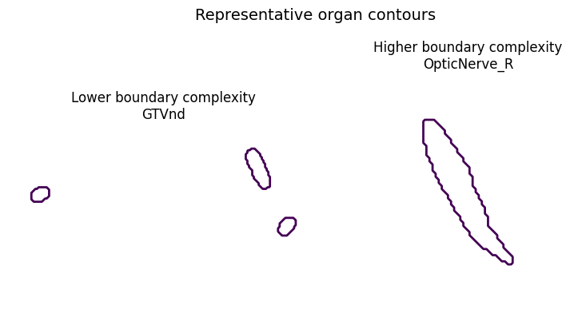
Annotation Boundaries Vary Between Organs
Takeaway: Differences in boundary geometry provide an additional dimension of segmentation difficulty beyond structure size alone.
Evaluation implication: motivates complementing overlap-based metrics with a boundary-sensitive metric.

Slide 47
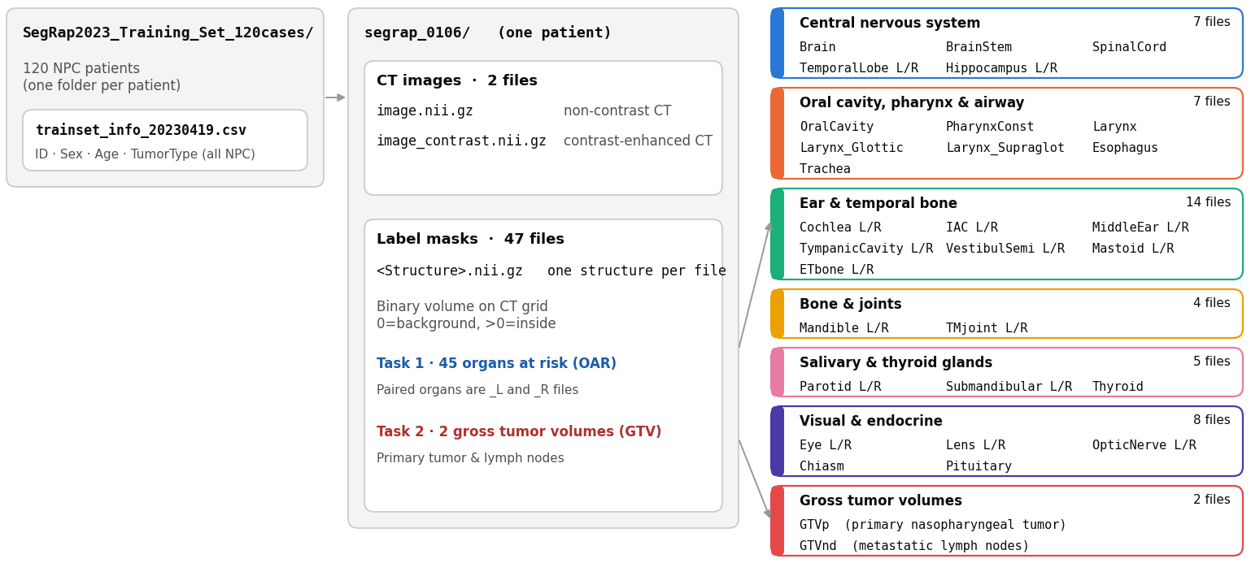
Annotation Characteristics
Takeaway: SegRap includes annotations on many different head neck and neck regions with metadata
Notes:
walk through this!
metadata, 120 patients in training set
CT images: noncontrast and contrast enhanced
Label masks are binary - induce overlab
Some organs are paired but this dataset labels separately

Slide 48
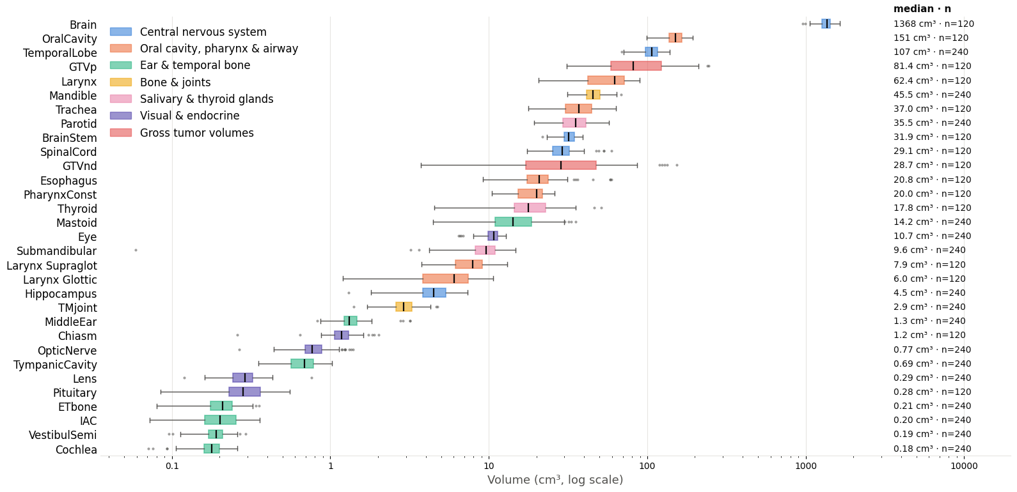
SegRap Labeled Regions Have Size Differences
Takeaway: Large differences in structure size may cause segmentation performance to vary across anatomical structures.
Notes:
explain n = 240
explain how some organ systems are larger
log scale
compare 3mm z axis slice difference to this - indicating that some of these might show up on a single slice so this is a hard problem!
motivates also scaling loss and whatnot

Slide 49
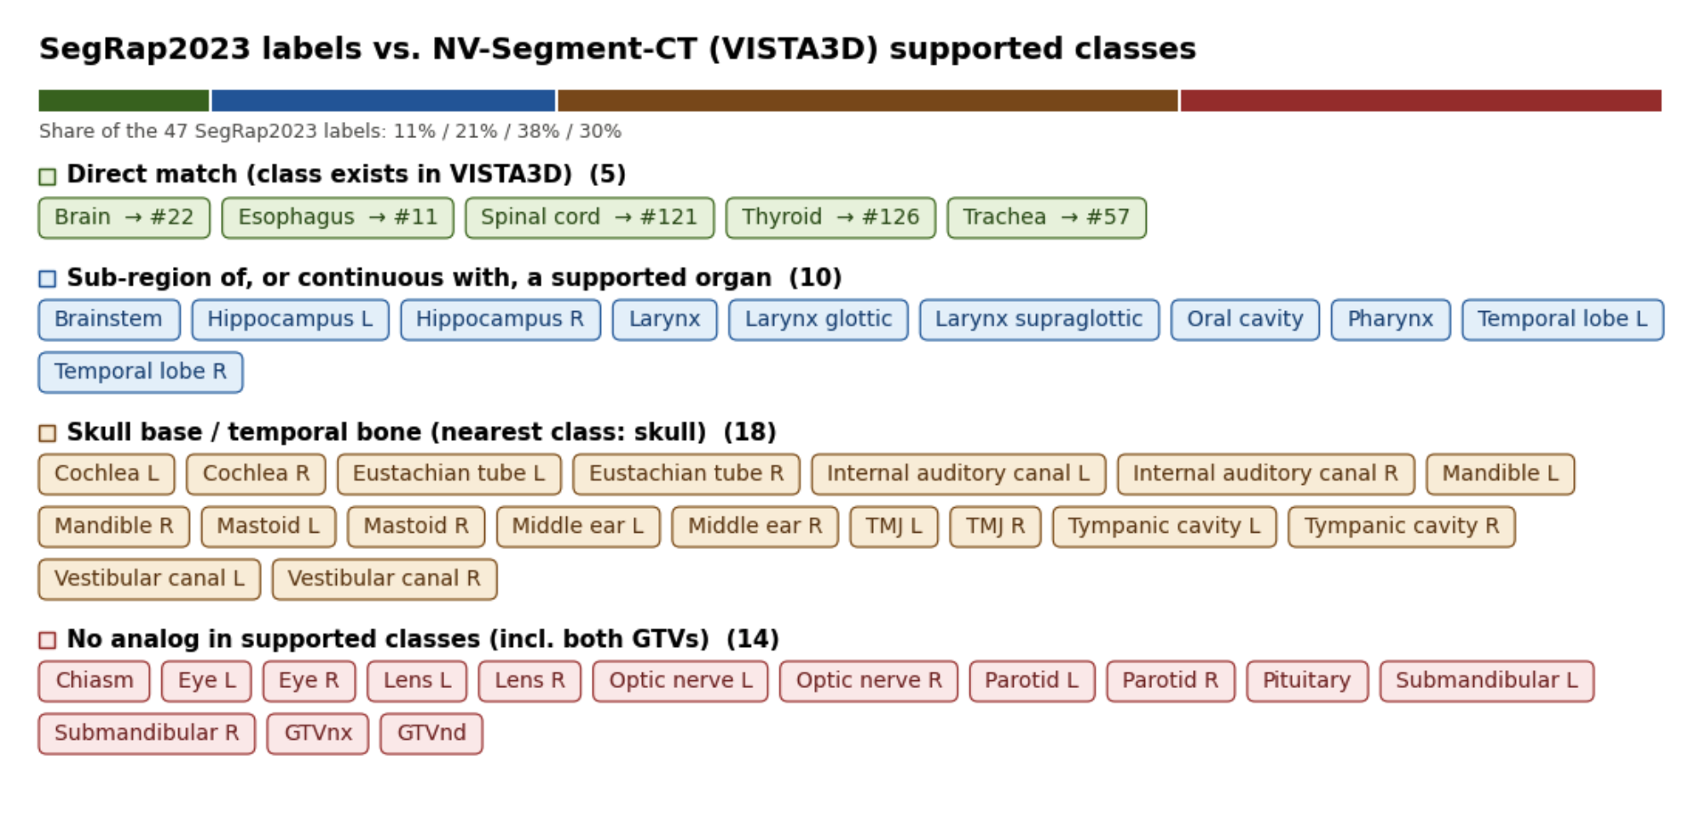
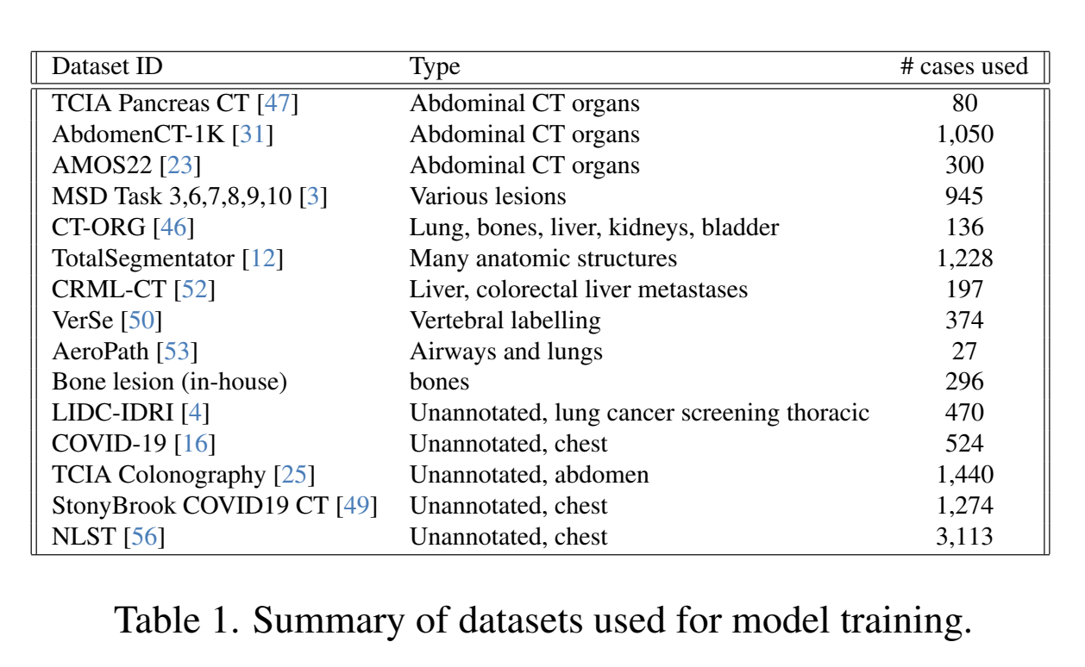
NV-Segment-CT validation of training labels
Takeaway: NV-Segment-CT allows for automatic segmentation of 127 classes, but only a subset may be applicable for predicting SegRap2023 labels

Slide 50
Plan for Next Week
Complete SegRap2023 EDA and finalize preprocessing
Finalize patient-level train/validation/test splits
Create 5, 10, 20, 40, and 80-patient training subsets
Set up the nnU-Net baseline training pipeline
Run initial nnU-Net experiment on the 5-patient subset
Verify training, inference, and Dice evaluation pipeline
Notes:
preprocessing next steps:
scaling up

Slide 51
Questions?

Slide 52
Do Foundation Models Help When Labels are Scarce?
Comparing nnU-Net and NV-Segment CT for 3D CT Segmentation
Adi, Arnav, Mina, Rayhan
09/24/26

Slide 53
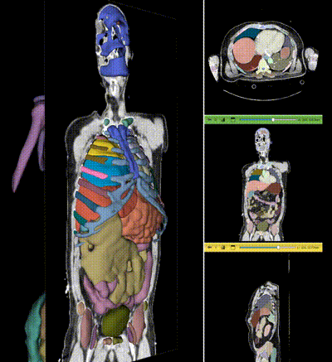
Biomedical Problem
3D segmentation requires voxel-level labels, but expert annotation is costly and time-consuming.
Can pre-training reduce annotation needs?
He, et al. 2025
Notes:
What is the biomedical/data problem?
He, Yufan, et al. "VISTA3D: A unified segmentation foundation model for 3D medical imaging." 2025 IEEE/CVF Conference on Computer Vision and Pattern Recognition (CVPR). IEEE, 2025.

Slide 54
Research Questions
1
Can pre-training reduce annotation needs?
2
When does pre-training outperform training from scratch?
3
Does the advantage decrease as labels increase?
4
Does the distribution of available labels matter?

Slide 55
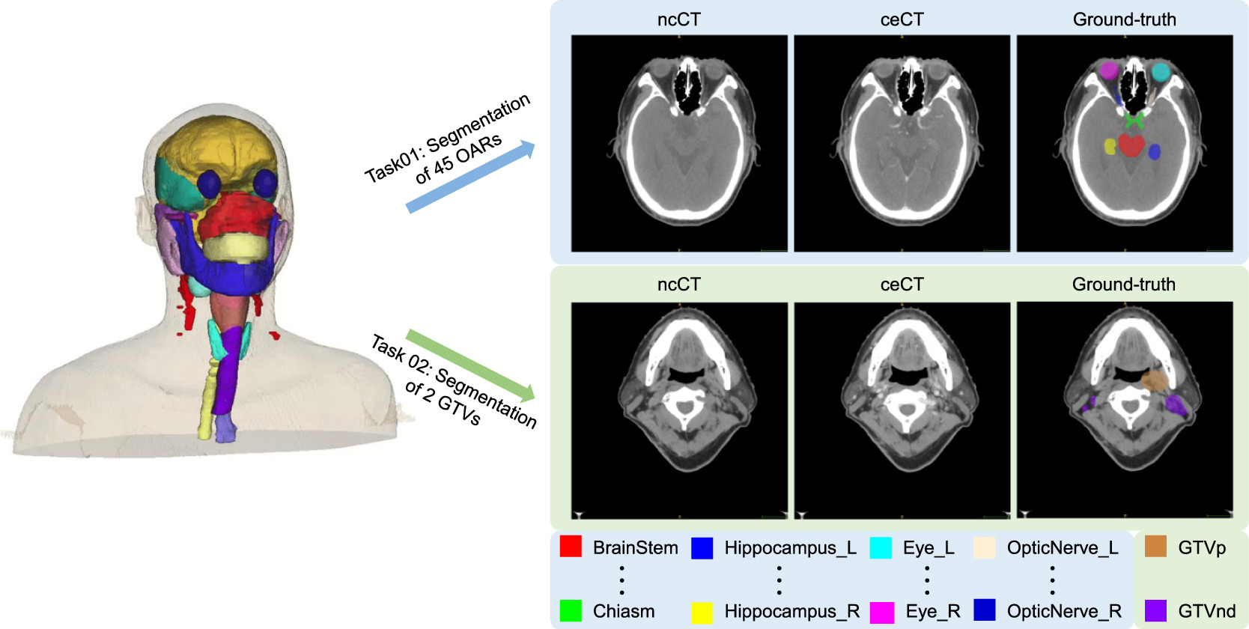
SegRap2023 Dataset: 200 patients with CT scans, 120 labeled patients for training, 45 organ expert labels (+ 2 tumor volumes)
Target output: 3D anatomical segmentation masks + labels
Dataset/Target Output
SegRap2023 nasopharyngeal cancer CT dataset
200 total patients with paired CT scans
120 labeled training patients used for experiments
45 organs-at-risk + 2 tumor volumes
Target output: 3D anatomical segmentation masks
Luo et al., 2025
Notes:
Luo, Xiangde, et al. "Segrap2023: A benchmark of organs-at-risk and gross tumor volume segmentation for radiotherapy planning of nasopharyngeal carcinoma." Medical image analysis 101 (2025): 103447.

Slide 56
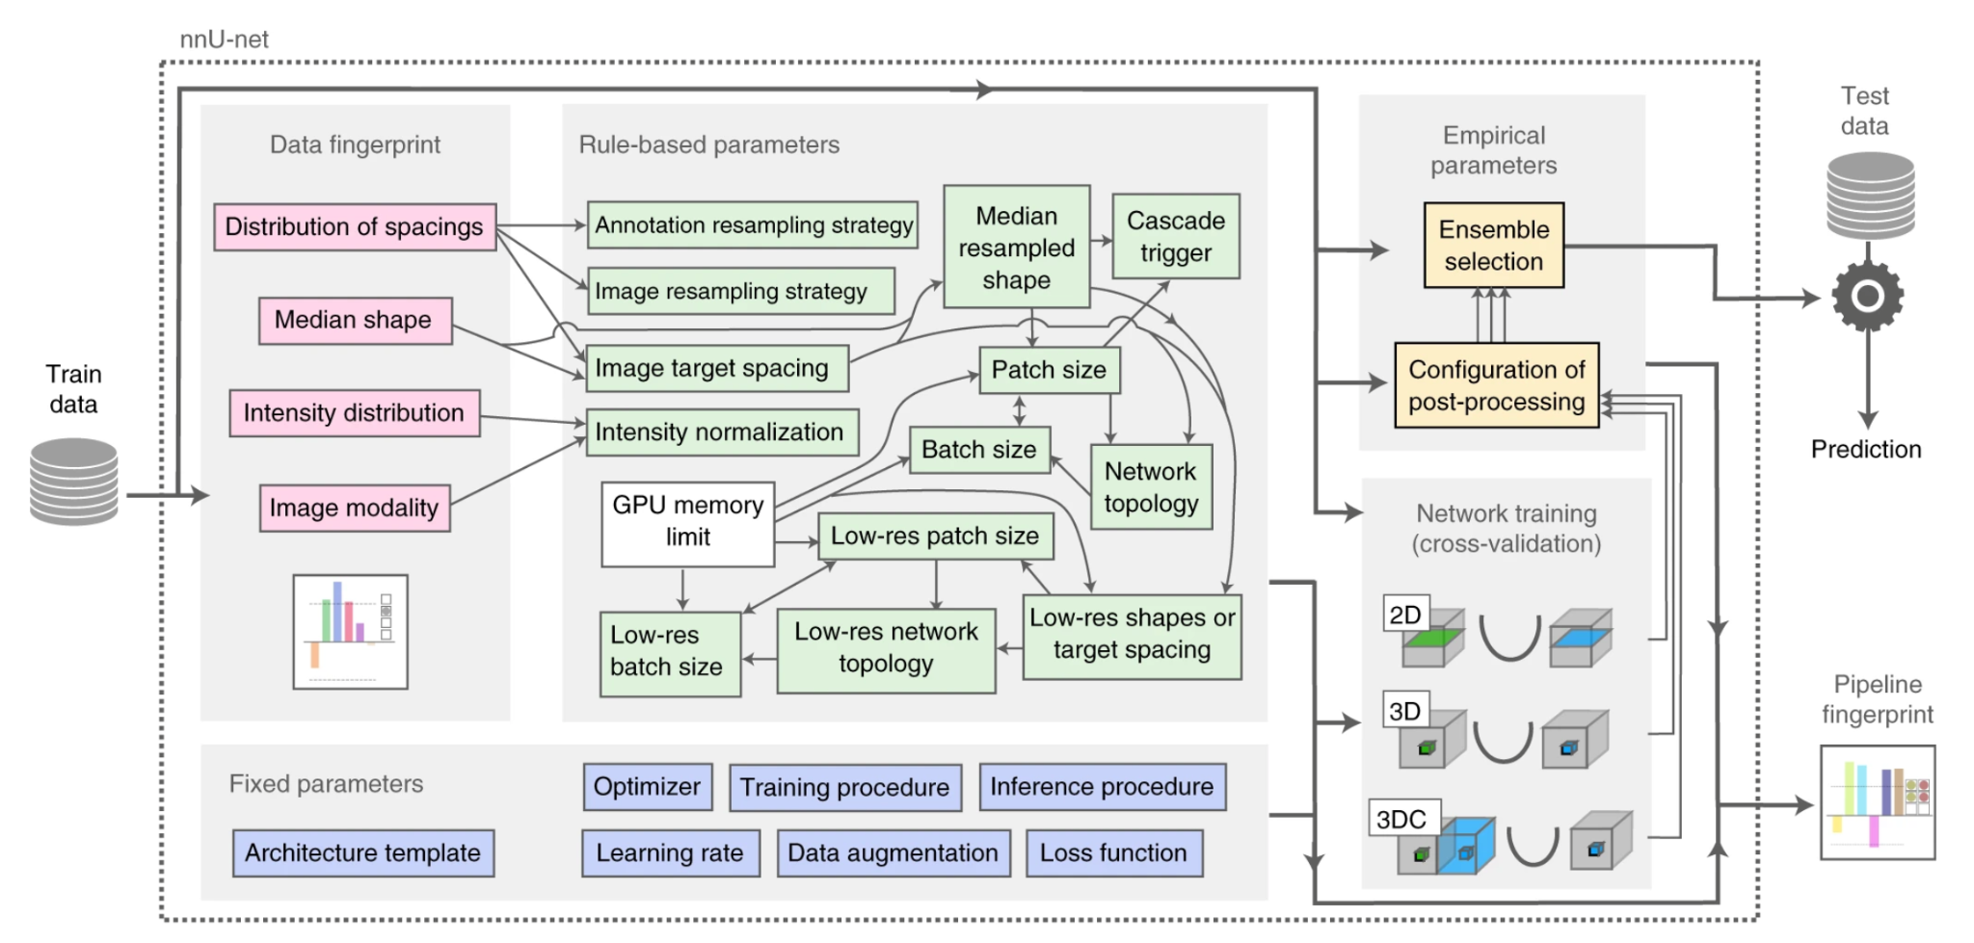
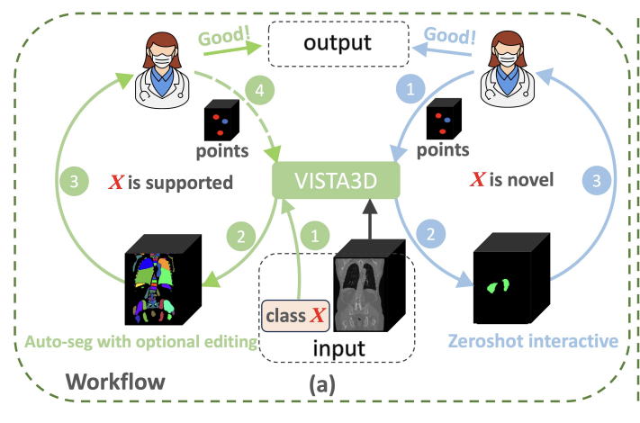
Models being compared:
Target Output
NV-Segment-CT
Pretrained 3D CT foundation model
Begins with learned anatomical representations
Fine-tuned using SegRap2023 labels
nnU-Net
Task-specific segmentation model
Trained from random initialization
Automatically configures the training pipeline
Isensee et al., 2020
He, et al. 2025
Notes:
https://liner.com/review/vista3d-unified-segmentation-foundation-model-for-3d-medical-imaging
https://www.nature.com/articles/s41592-020-01008-z#Fig2
He, Yufan, et al. "VISTA3D: A unified segmentation foundation model for 3D medical imaging." 2025 IEEE/CVF Conference on Computer Vision and Pattern Recognition (CVPR). IEEE, 2025.

Slide 57
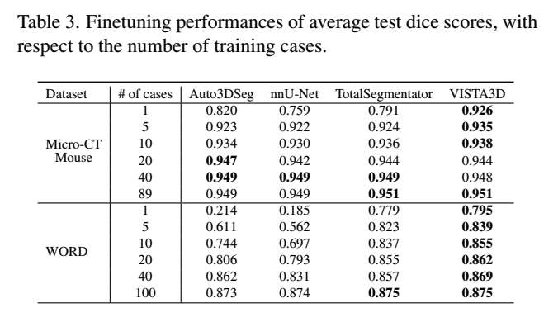
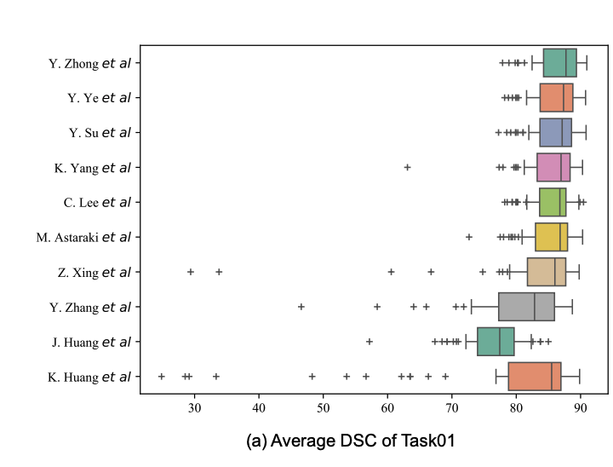
Previous Work
VISTA3D showed stronger performance on abdominal CT (WORD) with fewer cases, but this performance gap narrowed as labeled cases increased.
He et al., 2025
SegRap2023 solutions were largely nnU-Net-based, but pretrained universal models such as UniSeg were also competitive.
Luo et al., 2023
Notes:
Double check He et al., 2025 paper for VISTA3D and fine-tuning

Slide 58
Next Steps
1
Data validity: Verify SegRap2023 was not used during pre-training of NV-Segment-CT
2
Model adaptation with fully labeled patients
→ Select 5, 10, 20, 40, or 80 patients
→ Keep all target structure labels
→ Train nnU-Net from scratch + Fine-tune NV-Segment-CT
→ Compare on the same fixed test set
3
Model adaptation with partially labeled patients
→ Control the overall annotation budget
→ Select number of patients and number of structure labels (e.g. 10 patients x 45 structures vs 90 patients x 5 structures)
→ During training, missing structures treated as unknown, not background
→ Compare with the fully labeled setting

Slide 59

Compute Requirement
GPU cluster likely required
nnU-Net: ~16–32 GB GPU memory
Foundation-model fine-tuning: ~32–48+ GB useful

Slide 60
Expected Insights
Determine when pre-training provides the largest benefit
Determine whether labels are better spent densely or sparsely
Identify the most effective strategy under limited annotation resources

Slide 61
Questions?

Slide 62
First Questions We Will Investigate
Data validity: confirm no SegRap2023 overlap with foundation-model pretraining
Label budget: compare fully labeled patients vs. partially labeled patients
Model adaptation: compare nnU-Net training from scratch with NV-Segment-CT fine-tuning
Fine-tuning strategy: test partial vs. full fine-tuning across label budgets

Slide 63
Pre-training and Data Checks
Verify SegRap2023 was not used during pre-training
Check documented VISTA3D training datasets
No documented SegRap2023 overlap found
Identify SegRap structures represented in NV-Segment-CT
Map compatible labels between the two datasets
Notes:
Isensee et al., 2020

Slide 64
Experiment 1: Fully Labeled Patients
Select 5, 10, 20, 40, or 80 patients
Keep all target structure labels
Train nnU-Net from scratch
Fine-tune NV-Segment-CT
Compare on the same fixed test set

Slide 65
Experiment 2: Partial Labels
Use CT scans from a larger patient pool
Keep only selected structure labels per patient
Missing structures treated as unknown, not background
Control the overall annotation budget
Compare with the fully labeled setting

Slide 66
Overall Experimental Setup
Fixed training / validation / test split
Compare nnU-Net vs. NV-Segment-CT
Two label-scarcity settings
  Fully labeled patients
  Partially labeled patients
Label budgets: 5, 10, 20, 40, 80
Repeat sampling to measure variability
Compare two interpretations of label scarcity

Slide 67
First Questions to Investigate
Effect of label budget
Effect of label distribution
Partial vs. full fine-tuning
Foundation model vs. train-from-scratch baseline

